Slide 1



UNIT 1: INTRODUCTION
Meaning & Definition; Importance; Scope of OB; Contribution of other disciplines towards OB; Important
concepts challenges
in OB; Emerging in OB; Models of
Organizational
Behaviour; Collegial
Custodial, Supportive,
and System (Concept only).
Unit 1 – Introduction
1

Slide 2



MEANING OF ORGANIZATION
Organization:
“Organization is the structural framework of duties and responsibilities required for a person in performing various functions within the company”.
“Organizations are simply groups with two or more
people that share a certain
set of goals and meet at regular times”.
Behaviour:
“It is a human tool for human benefit. How people act or behave”.
“It occurs in organizations”.
3
Unit 1 – Introduction
2

Slide 3

Meaning of Organizational Behaviour:
Organizational behaviour means human behaviour- the behaviour of the individuals i the organization.
Behaviour of employees
would help the managers to
n
drive optimum (favourable outcome, something,
make the best) results out of their efforts.
success of
Behaviour within organizations improves an organization's effectiveness.
4
Unit 1 – Introduction
3

Slide 4

Definition: (O + B = OB)
“Organizational behaviour is the study and application of knowledge about how people - as individuals and as groups behave or act in organizations and how organizations
manage their environments. It strives to identify ways in which people can act more effectively”.
“The study of human behaviour in organizational settings, the interface between human behaviour and the organizational context, and the organization itself”.
“Organizational behaviour is directly concerned with the understanding, prediction,(behaving or occurring in the way expected) and control of human behaviour 5 in
organizations”.
Unit 1 – Introduction
5

Slide 5
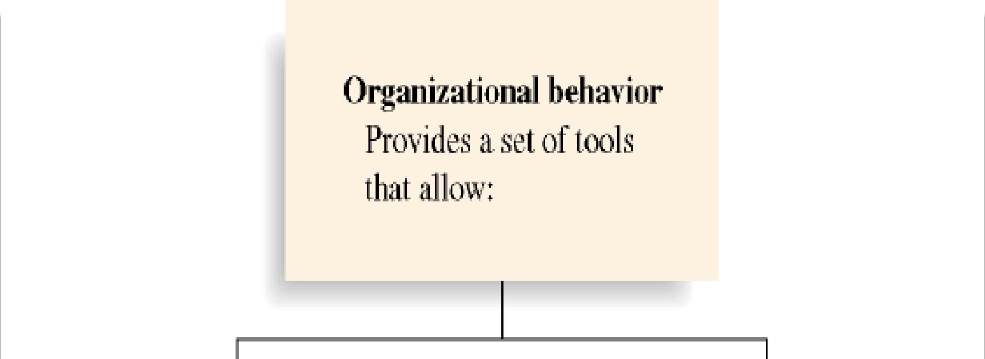

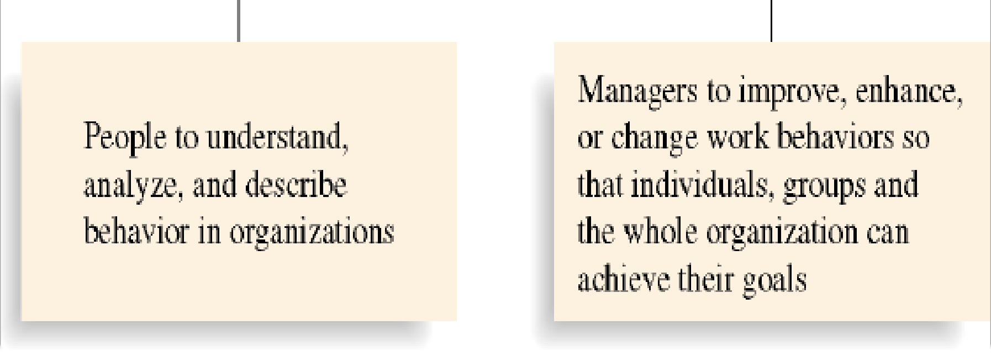
5

Slide 6
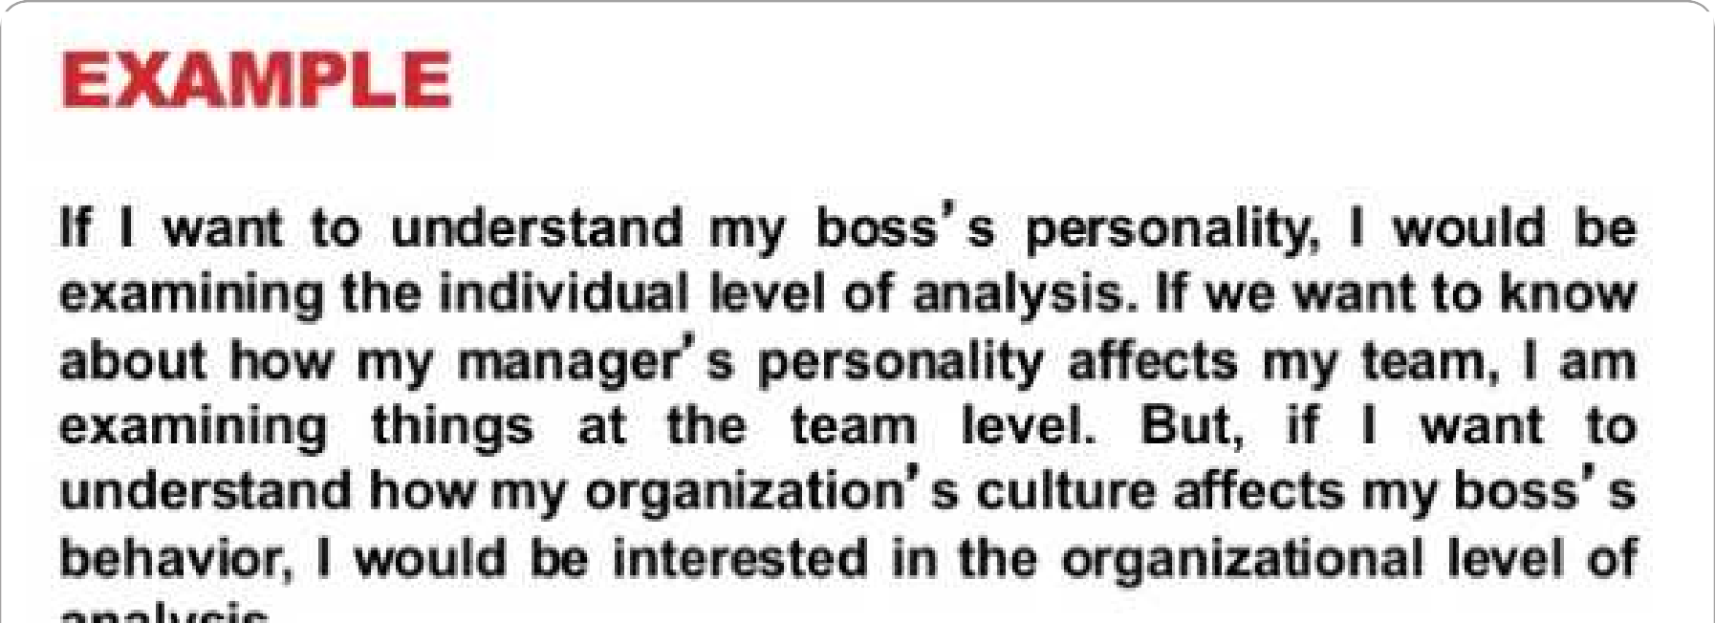

6

Slide 7











WHY ORGANIZATION EXIST?
Five Reasons why organization exist:
Increased specialization and division of labour
Use large – scale technology
Which increases the value that an organization can create
Organization allows people jointly to:
Manage the external environment
Economize on transaction costs
Exert power and control
8
7

Slide 8


Need to study OB:
To secure better labour- management relationships
(motivating employees).
To identify individual differences and how to deal with others (people differ in their knowledge, attitude, intelligence, capacity, skill, memory and so on).
To overcome resistance (organization that fights against an enemy trying to prevent by action or argument).
To understand group behaviour.
To provide counseling
(advise someone with personal problems
To manage conflicts
(misunderstanding).
).
To introduce change.
Some want to be managers or Entrepreneurs.
9
9

Slide 9
Nature of Organizational Behaviour:
It focuses on the behaviour of individuals (studies why people in the workplace behave in a particular way).
It is inter- disciplinary (It studies relevant things from science subjects psychology, sociology and anthropology).
Psychology - The study of the human mind (mental characteristics).
Sociology - The study of the human society (people).
Anthropology -The study of the human cultures.
It is an applied science (makes use of research findings to solve organizational problems relating to human behavioral aspects).
4.It is an art as well (not only science, even skills are also important to understand human behaviour).
10
1 0

Slide 10

5. It adopts a humanistic approach ( fulfilling the needs of the individuals i.e. support and involvement).
Its ultimate aim is to attain the organizational objective (by having positive human behaviour the objectives are achieved).
A total systems approach (systems approach tries to find solutions for the variables affecting organizational functions).
Characteristics of OB:
Goal – Oriented.
Levels of Analysis.
Human tool.
Satisfaction of employees need.
11
Unit 1 – Introduction
1 1

Slide 11
Importance of OB:
It not only makes an individual a better employee of an organization but makes better person with positive attitude.
It contributes towards better quality of life.
It provides a road map to our lives in organization.
The field of OB uses scientific research to help us understand and predict organizational life.
OB helps us influence organizational events in order to influence the environment in which we live.
OB helps an individual understand himself and others better to improve the interpersonal relations.
Manager in a business establishment is concerned with getting things done through delegation.
The field of OB is useful for maintaining cordial industrial
Unit r1 –elInatrtodiuoctnions.
1 2

Slide 12





The subject of OB is also useful in the field of marketing.
The most popular reason for studying OB is that the reader is interested in pursuing a career in management and wants to learn how to predict behaviour and apply it in meaningful way to make organization more effective.
Basic Process of OB:
UNDERSTANDING
PREDICTION
What patterns of behaviour are present?
What is the cause
– effect relationship?
CONTROLLING
What solutions are possible?
Which variables can be influenced? How can they be influenced?
How strong are they?
How do they interrelate?

Slide 13
Scope of Organizational Behaviour: (Key Elements)
People:
people differ in their knowledge, attitude, intelligence, capacity, skill, memory and so on. Managers should identify the individual differences before assigning work.
Structure:
without structure it is difficult to secure effective co- ordination of the departmental activities.
Technology:
uses of better technology enables the employees to work with greater efficiency. This improves their satisfaction and feelings.
13
1 4

Slide 14


Environment:
both internal and external environment also influences working relationships.
Individuals:
organizations are the association of individuals differs in
different respects like personality, values, learning and motivation.
6. Group of Individuals:
- groups include aspects such as group dynamics, group conflicts, communication, leadership, power and politics.
perception, attitudes,
14
1 4

Slide 15

IMPORTANT CONCEPTS OF ORGANIZATIONAL BEHAVIOUR (FOUNDATIONS)
Individual differences:
people differ in their knowledge, attitude, intelligence, capacity, skill, memory, etc.
Perception.
Concept of Whole person:
it is not the skill or the intelligence of the individual alone is important for the growth of organization, mainly the personal life of individual helps to get the best out of him.
Motivation.
Involvement / Empowerment.
Dignity of Labour – treated with respect.
Social System – should work for a common goal.
Mutuality of Interest:
it is the organization that satisfied the needs of the peo¹p⁶ le,
then there is mutuality of interest.
1 6

Slide 16
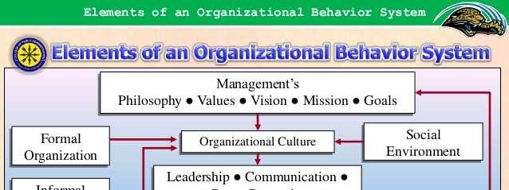
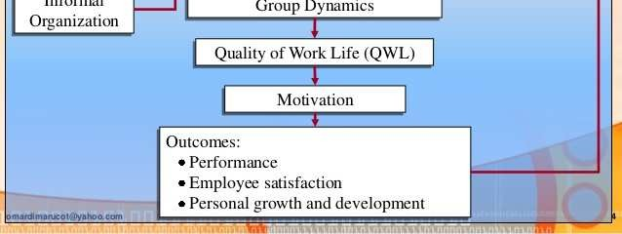

Slide 17
FRAMEWORK OF ORGANIZATIONAL BEHAVIOUR (OR) PROCESS
As mentioned earlier organizational behaviour studies
human behaviour at work.
Organizational behaviour can be the behaviour of the members of the organization towards each other, towards the organization, towards the customers or clients, & towards the society at large.
This circle represents organizational frame work. It contains
3 levels of managers.
Top level managers ( TM )
Middle level managers ( MM )
Lower level managers (LM )
d) People ( P )
18

Slide 18
The hierarchy ( things one above the other according to status) of managers is indicated by the triangle within the overall organizational framework.
It represents managerial effectiveness & human relations.
It exhibits that the behaviour of one individual serves as cause for another’s behaviour. The behaviour of another individual thus become effect.
(E.g.) If the behaviour of TM towards its people ( P ) is with more effect, then other levels management will make effect in the whole organization.
Finally it shows a positive relationship between human relations & managerial effectiveness in the organization. Better the human relations maintained among the people, greater would be the positive behaviour & in turn greater would be the managerial effectiveness.
19

Slide 19
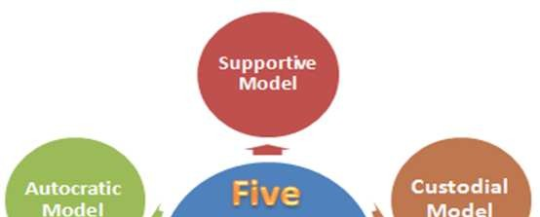
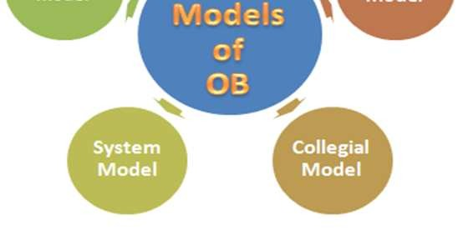
MODELS OF ORGANIZATIONAL BEHAVIOUR (OB)
20

Slide 20
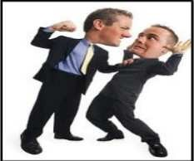
1. Autocratic model:
Under autocratic model, the managers uses authority and directs the subordinates to do work as per his specification.
The subordinates are not given freedom to act. They have to carry out the task faithfully as per their boss's instruction.
The employees are made to work like machines.
The use of such an approach may not always give the manager the desired results. Employees physical & mental health gets affected.
Organizations may also begin to face behavioural problems as a high rate of absenteeism, low morale
(feelings of confident & satisfaction), high rate of labour turnover and so
on.
21
Unit 1 – Introduction
2 1

Slide 21

2. Custodial:
Employees has to depend on the organization.
The organization takes care of all the
need of the
employees like rent free accommodation, free education for his children, food and so on.
Under this approach the employee is happy organization satisfies his needs. But there will guarantee that his performance level will be high.
as the
be no
21
2 2

Slide 22
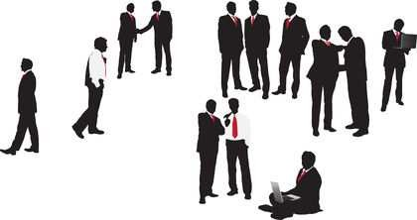
3. Supportive:
The managers supports his subordinates in the performance of their tasks.
The focus here is managerial leadership.
The manager does not make decision but involves his subordinates in the decision making process.
This model is suitable in those workplaces where the employees are self motivated.
22
2 2

Slide 23


4. Collegial:
The managers and subordinates work as a team.
The manager participates in the process of task performed by subordinates.
There is better interaction among team members.
Every subordinate is able to be self disciplined.
23
2 2

Slide 24
COMPARISON OF 4 MODELS OF ORGANIZATIONAL BEHAVIOUR
 | Autocratic | Custodial | Supportive | Collegial
Basis of model | Power | Economic resources | Leadership | Partnership
Managerial orientation | Authority | Money | Support | Team work
Employee orientation | Obedience | Security and benefits | Job performance | Responsible behaviour
Employee psychological result | Dependence on boss | Dependence on organization | Participation | Self-discipline
Employee needs met | Subsistence (Basic level) | Security | Status and recognition | Self- actualisation
Performance result | Minimum | Passive cooperation (Accepting what happens ) | Awakened drives (Perform well) | Moderate enthusiasm 25

Slide 25
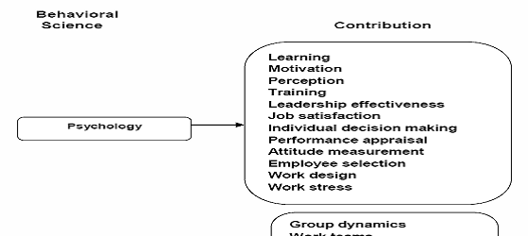
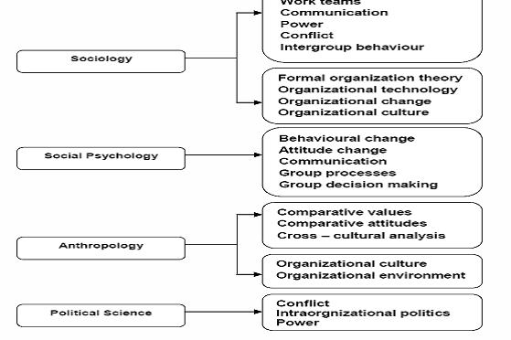
OTHER DISCIPLINES CONTRIBUTE TO
ORGANIZATIONAL BEHAVIOUR (OB)
Important disciplines contributing to OB are:
26

Slide 26
a)Psychology - the study of the human mind (mental characteristics).
- it includes perception, learning, memory, attitude, opinion, capacity to judge, ability to make decision.
- knowledge of psychology provides the manager to influence the employees positively towards the goals.
Sociology - the study of the human society (people).
sociology deals with the social behaviour of an individual. - an employee, for example may strike work not on his own but due to union pressure.
knowledge of sociology helps the manager to tackle group behaviour effectively.
Anthropology - the study of the human cultures and practices
in different societies.
it is a study of fundamental values and beliefs (trust), useful
in understanding human behaviour.
Unit 1 – Introduction
27
2 7

Slide 27
APPROACHES IN ORGANIZATIONAL BEHAVIOUR (OB)
Human resource or supportive approach:
it is concerned with growth & development of people towards higher levels.
it is supportive approach because managers primary role change from control of the employees to achieve support of their growth & performance.
it helps an employee to become better, more responsible & create a climate in which they can contribute to their improved abilities.
Situational or contingency approach:
ideas are suppose to apply in any type of situation.
situational approach are much complex may require different
behavioural pattern & practices for more effectiveness.
it helps to use the most appropriate manner, all the curr2e8 nt
knowledge about people in organization.
2 8

Slide 28
Productivity approach:
Productivity is the ratio that compares the units of output with units of input, better productivity is a valuable measure of how well resources are used in society.
Productivity often is measured in terms of economic inputs & outputs but human inputs & outputs are also important. (E.g.) better organizational behaviour can increase job satisfaction (i.e.) human output.
System approach:
a system implies that there are many variables in organization. Each of them affect all the other in a complex relationship (a set of repressed feelings affecting behaviour) which appears to affect one individual or department in the organization.
all people in organization should be concerned with improving organizational behaviour.
28
2 9

Slide 29
PROBLEMS IN THE STUDY OF ORGANIZATIONAL BEHAVIOUR
Behaviour of an individual cannot be studied.
Behaviour of an individual may be different from a group.
No formula or method is used to study.
Conflicts between personal and organizational goals.
Perceptions, values, beliefs etc are not static.
Style of leadership for all managers are different.
Not possible to offer a solution to a certain
behavioural problem.
29
2 9

Slide 30









EMERGING CHALLENGES OF OB
Managing Diversity
Changing demographics of workforce
OB
Challenges
Technology transformation
Globalization
Changed Employee expectations

Slide 31
The challenges include –
1. Managing Diversity:
“Diversity is dealing with a collective mixture of differences and similarities in a given group.”
(i.e.) Primary dimensions – age, gender, mental / physical abilities and characteristics, race, ethnic heritage, etc.
Secondary dimensions – education, geographic location, cultural experience, work experience, religion, work style, family status, etc.
it is a philosophy about how differences among individuals are accepted and respected and how they are made to work.
there is diversity in all aspects of workforce makes not only a strong moral but also business sense.

Slide 32
Diversity is built in various groups of members in organization to achieve –
Access to a changing market place.
Large scale business transformation.
Superior customer service.
Workforce empowerment.
Total quality.
Alliances with suppliers and customers.
Continuous learning. (E.g.)
i) Procter & Gamble achieves 30 – 40% higher productivity at its 18 diverse team based plants than at its non – diverse plants.

Slide 33
Barriers to accept diversity:
Prejudice – unjustified negative attitude towards a person based on his or her membership of a particular group.
Ethnocentrism – tendency to regard one’s own group, culture, or nation as superior to others.
- this occurs in selective club, religious or political.
Stereotypes – set of beliefs about a group that is applied universally to all members of that group.
Discrimination – barring an individual from membership of an organization or from a job because of his or her membership of a particular group.
Harassment – consciously shunning or verbally or physically abusing an individual.
Backlash – negative reaction to the gaining of power influence by members of previously under represented groups,
leading to fear and reverse discrimination.
3 4

Slide 34
Manage diversity effectively:
Increasing awareness:
awareness demands appreciation of diversity as a fact of organizational life.
diversity awareness programmes in organizations strive to increase managers and worker’s attitude, biases, stereotypes, differing perspectives of diverse managers, co- workers.
Increasing Diversity Skills:
efforts to increase diversity skills focus on improving the managers and subordinates interaction and improving skill.
it educate the way of thinking, communication, issues and situations to develop healthy respect and mutual understanding.

Slide 35
Cultural diversity:
this diversity in workplace is growing because of
globalization.
the challenge to OB is to harness the wealth of differences
that cultural diversity provides.
Strategies to manage cultural diversity:
For individuals:
live and work outside your home country.
develop friendship with people from nationalities other than your own.
learn another language.
subscribe newspaper and periodicals that brings key issues from multinational perspective.

Slide 36
For companies and Organizations:
offer language training to employee.
encourage employees to accept non home country assignments.
provide transaction counselling to employees and families.
provide training to help employees learn about cross cultural differences.
iv) Gender diversity:
the feminization of workforce has increased substantially.
women’s participation in the workforce is increasing.
(E.g.) women hold 11.2% of corporate officer positions in Fortune 500 companies.
it allow individuals and organization to move away from discriminating or making false assumptions while managing with diverse groups.

Slide 37
Committing Top Management to Diversity:
managers embrass diversity through their actions and spread messages that diversity can be source of competitive advantage.
organization takes steps to manage diversity and success in their efforts to manage diversity.
diversity management efforts have backfired, leaving race and gender divisions even greater.
experts recommended that managing diversity demands expecting a range between people.

Slide 38
Changing demographics of Workforce:
it relates to dual career couple where both partners are actively pursuing professional careers.
organization use physical relocation for developing talent.
dual career professionals limits individual flexibility in accepting assignments.
another change in workforce relates to growing no. of young employees and people who join jobs are fresh graduate.
young people who are fresh, ambitious and enthusiastic
are handled with circumspection.
changes in the workforce demographics have their own implication for managers in the organization.

Slide 39
Changes Employee Expectations:
employee expectations and attitudes have changes due to changes in workforce demographics.
employees demand empowerment and expect quality of status with management.
empowerment results in redefining job, control over their jobs and gain knowledge about work methods.
expectations breaks traditional relationships between employee and owners.
today’s worker demands better treatment, challenging assignments and career advancement.
unions demanding so much pay rise, intensive training program to upgrade their skills, job security, monetary benefits, uniform, housing and other facilities.

Slide 40
Globalization:
growth internationalization of business has its impact on people management.
it cope with problems of unfamiliar laws, languages, practices, competitors, attitudes, management styles, work ethics.
personal function like hiring, training, compensating
acquire global perspective.
management should be flexible and proactive which makes contribution to company’s growth.
it is the source of competitive advantage for the company.
Advantages:
a) Globalization affects an increasing no. of managers and professionals.

Slide 41
b) Internationalization
puts a premium on certain
competencies (or skills).
Managerial learning is a crucial process in internationalization, bringing teamwork strongly to the fore.
Managers of career in context of globalization brings about for peculiar difficulties many companies.
Technology Transformation:
it refer to something as abstract or formula, offers competitive edge to a firm.
this competitive edge comes when managers achieve harmonious integration of their human and technological resources.

Slide 42
Dimensions of Technology:
Automation – it occurs when a task performed by a worker is mechanized to be performed by a machine.
it has impact on job design (i.e.) simplification of task for the worker.
it changes the job level of the worker from assembling a product and monitoring the machines.
it needs to understand the effect on jobs.
it works as a supplements and create some awareness of potential of worker alienation.
employees must plan for effects on automation of workforce, which includes displacement, replacement or retaining.

Slide 43
Information Technology – it influence the organizations and forcing OB scholars to re – examine their concepts in light of revolutionary changes.
it reshaped organizations and their interactions with other entities.
the entire world belongs technology – based products with internet, e-mail, mobile phones, etc.
Implications of advanced technology:
Learner organization:
every organization becomes learner through latest technology.
changes in technology makes organizations downsizing or rightsizing and enable the fewer employees to produce greater volumes.

Slide 44
outsourcing is one of the process of hiring outside firms to perform non – core activities of business.
outsourcing results in fewer no. of employees in organizations, sometimes fewer employees may lost their jobs.
- nowadays organization
machines, computer and
has good infrastructure,
other facilities, which is
challenging for manager’s to satisfied and motivate the employees.
Wired Organization:
organization has telecommunication facilities which keeps people away from office.
employees can operate from their home and need to visit the offices if they required.
(E.g.) web conference, webinars, internet and e-mails.
4 5

Slide 45
wired organizations pose another challenge how – to motivate employees, which becomes as issues in organization.
organizational hierarchies is another challenges for organization (i.e.) who was boss, who report to whom were clearly defined and identified.
- time differences across globe is another problem.
(E.g.) Call centres
Virtual offices:
it is one in which people work anytime, anywhere and with anyone.
it involves work being done from where people are,
instead of people going to work place.
IT makes connectivity, collaboration and communication
easy.
Unit 1 – Introduction
4 6

Slide 46
Changing nature of management work:
technological innovations affect the very nature managerial work.
the work environment is vastly different now compare to earlier days.
in earlier days work environment has risk in physical injuries, accidents, pollution and it tough task for manager to monitor the worker’s movement.
now the technology has altered the work environment and stressed the workers both physically and psychologically.
computerized monitoring provides managers with a wealth of information about employee performance.
managers need to upgrade their skills constantly.

Slide 47
technology changes occur so rapidly in present that turbulence characteristics most organizations.
every employees must constantly learn and adapt to changing technology to remain competitive.
managers must efficiently deal with the challenge of helping workers adapt and make effective use of technology.
nowadays the new generation workers have both business skills and technological expertise.
the organization should include awareness of how to integrate benefits of new technologies with organization’s human resources.

